Slide 1


PREDICTIVE MODEL OF
JOB PLACEMENT
BASED ON SEVERAL FACTORS

Slide 2



INTRODUCTION
Describing Dataset
Describing Dataset
CONTENT
Describing Dataset
Fitting models
CONCLUSION

Slide 3
INTRODUCTION

Slide 4

PROBLEM STATEMENT
Almost every students comes to a very vital juncture post high school that is getting admits from their dream university. Similar was the case for John. He was most concerned about the job placement scenario once he graduates.
The problem he faces is multifaceted: How can he accurately assess and compare the employment outcomes of different institutions? And how can these statistics reflect the true value of the education and opportunities that await him? This analysis is crucial, for it will shape his educational journey and, ultimately, his career trajectory.

Slide 5

RESEARCH QUESTIONS
How do different factors such as gender, streams, college name, gpa, degree, research paper, co-ops, no. of technical skills etc. affect the overall employment outcome?
IMPLICATIONS
The project's implications are profound, as it empowers students like John to make informed decisions about their education and future careers, potentially shaping their lifelong success and fulfillment.

Slide 6



PLAN TO ACHIEVE FROM
PROJECT
The project aims to provide John with a comprehensive framework to evaluate and compare the employment outcomes of various universities accurately. Ultimately, it seeks to empower him in making informed decisions that align with his educational and career goals.
PRIMARY GOAL OF THE
PROJECT
The primary goal is to develop a robust methodology for evaluating and comparing job placement outcomes among universities. This will enable informed decision-making for students like John, enhancing their educational and career prospects.

Slide 7
DESCRIBING DATASET

Slide 8



OUR
DATASET
This data is derived from Kaggle. It contains 11 columns and 500+ rows.
job_placement.csv contains details about Bachelor's degree graduates from diverse American universities and their employment status. The information includes attributes such as gender, age, academic field, university affiliation, placement status, placement-associated salary, GPA, years of professional experience, research papers, co-ops and no. of technical skills.

Slide 9
VARIABLES OF THE
DATASET
ID
Name
Gender
Age
Degree
Stream
College Name
Placement Status
Salary
GPA
No. of research papers
No. of Co-ops
No of Technical skills

Slide 10
DESCRIPTIVE DATASET

Slide 11
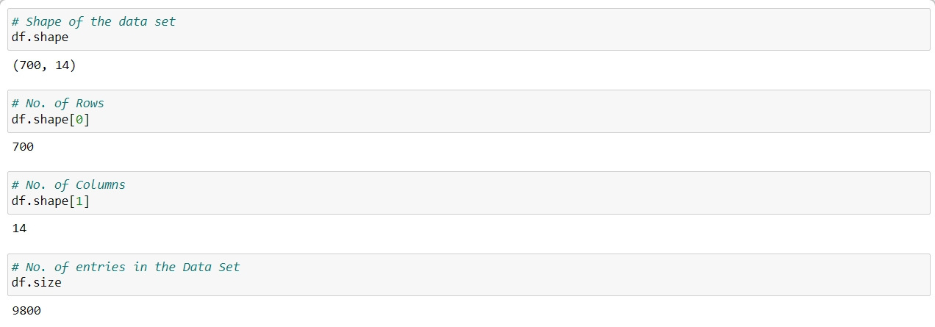
NUMBER OF
ROWS & COLUMNS

Slide 12
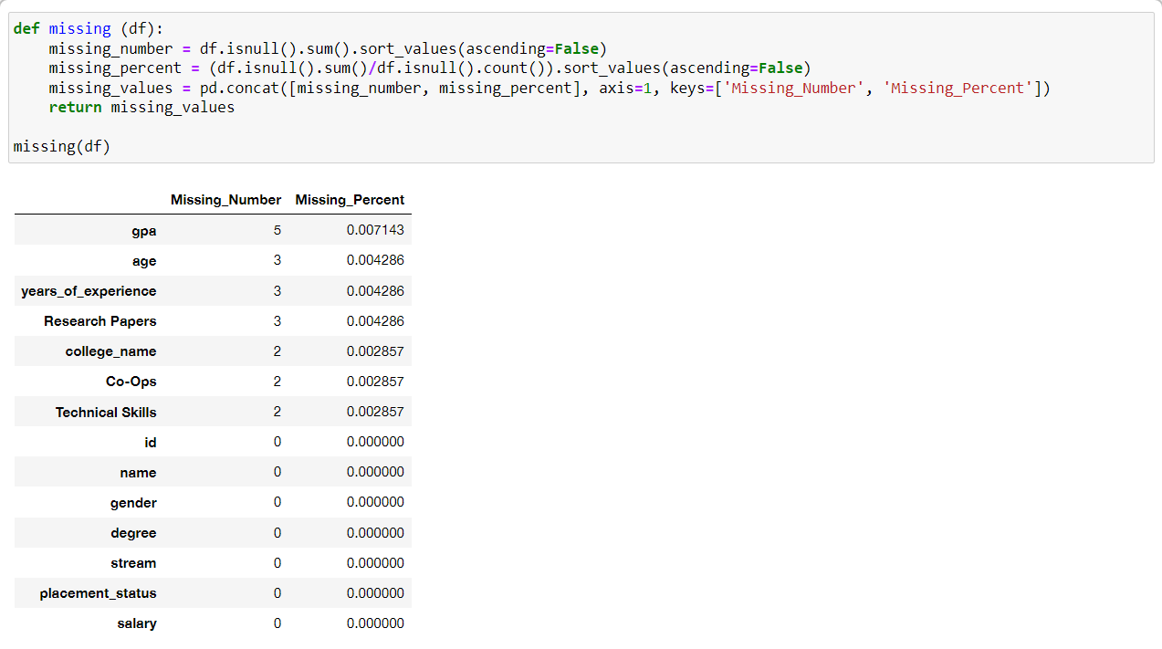
PERCENTAGE OF
MISSING VALUES COLUMNS

Slide 13
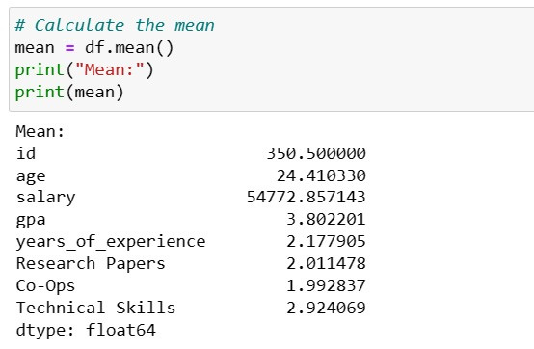
MEAN

Slide 14
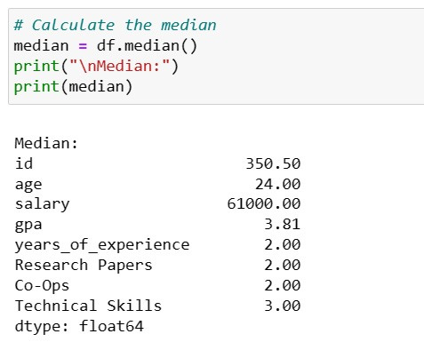
MEDIAN

Slide 15
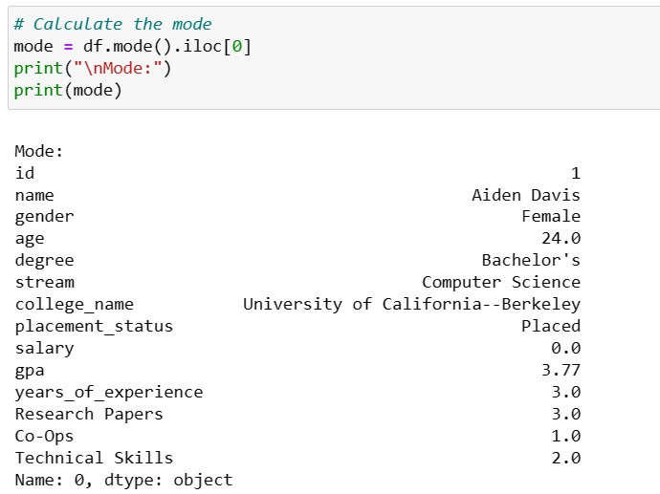
MODE

Slide 16
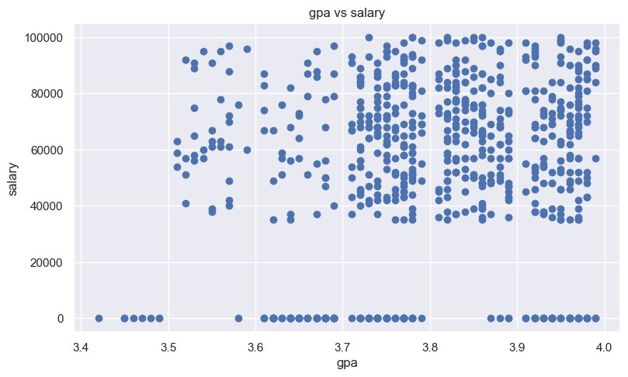
DATA VISUALIZATION
SCATTER PLOT
The scatter plot graph illustrates a positive correlation between GPA and salary, suggesting that higher academic achievement may lead to increased earning potential.

Slide 17
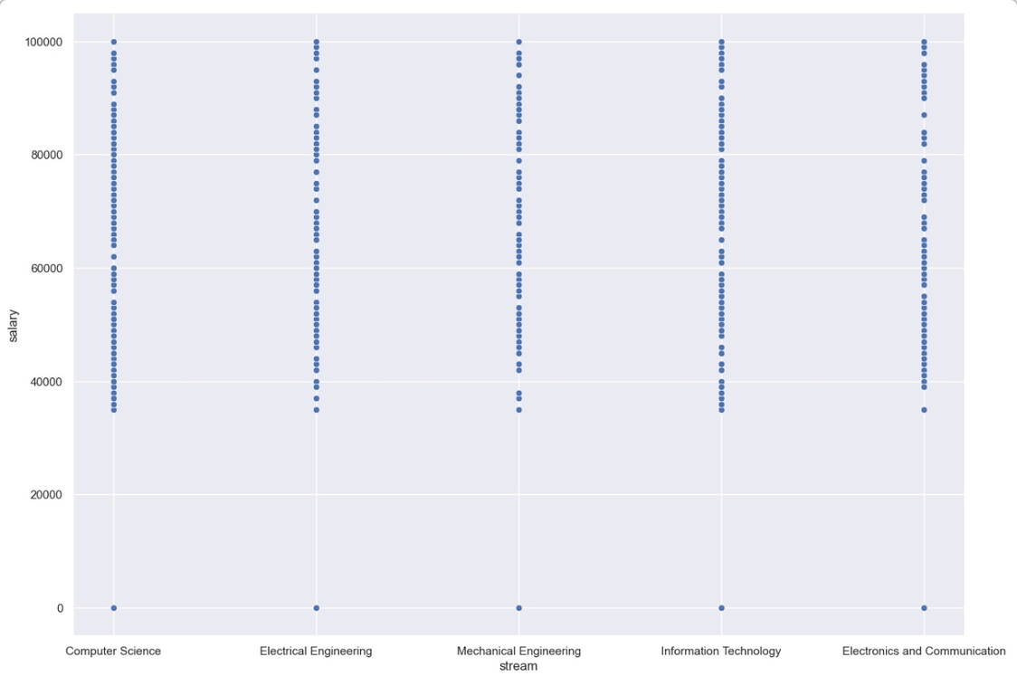
DATA VISUALIZATION
SCATTER PLOT
The graph depicts salary distributions across engineering fields, showing wide individual variances but similar averages, indicating diverse earning potential within each discipline.

Slide 18
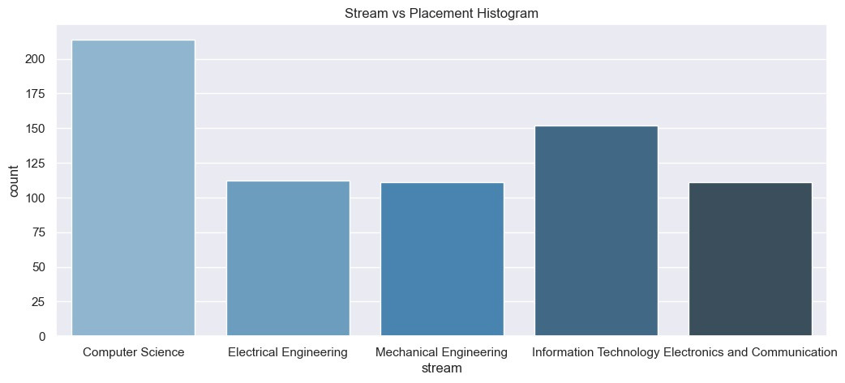
DATA VISUALIZATION
HISTOGRAM
The histogram illustrates the student distribution across engineering streams, with Computer Science being the most popular, followed by Information Technology and other fields.

Slide 19
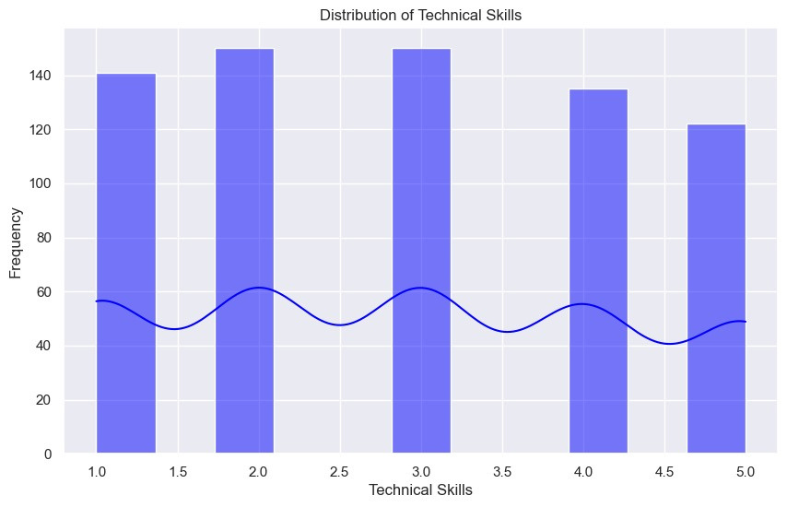
DATA VISUALIZATION
FREQUENCY CHARTS
The graph visualizes the prevalence of different technical skill level. It combines a bar chart showing the actual counts or proportions of people in each skill level category with a line chart that may indicate a trend or cumulative distribution across skill levels.

Slide 20
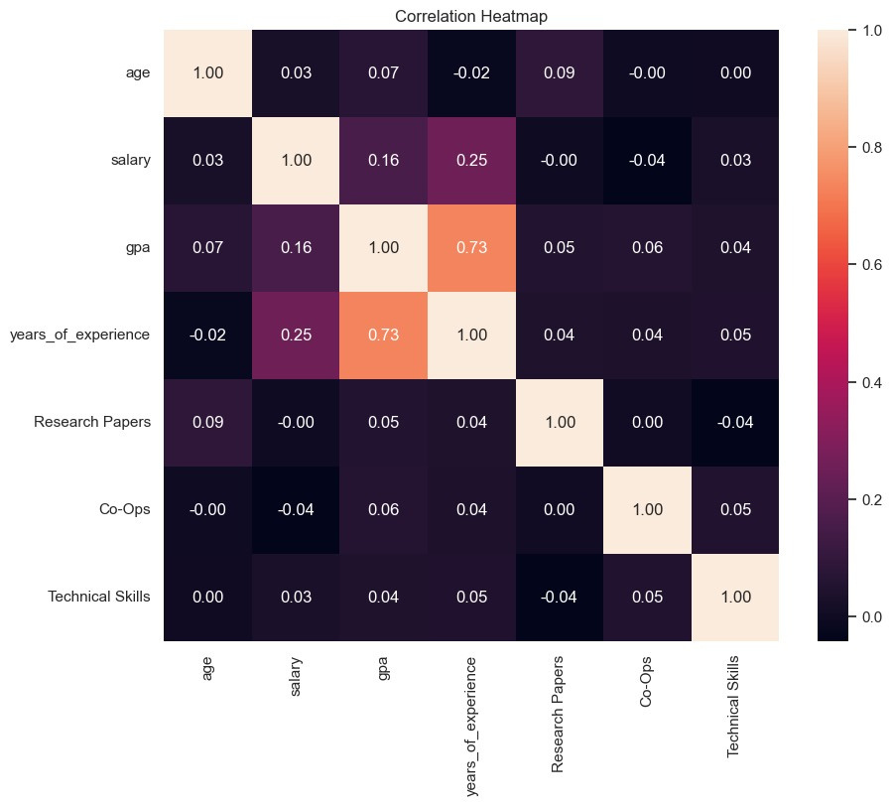
CORRELATION
The heatmap reveals intricate correlations among variables like GPA and years of experience with salary, offering insights into factors influencing income. Stronger correlations suggest significant relationships that could inform career and education strategies.

Slide 21
DATA PREPROCESSING

Slide 22
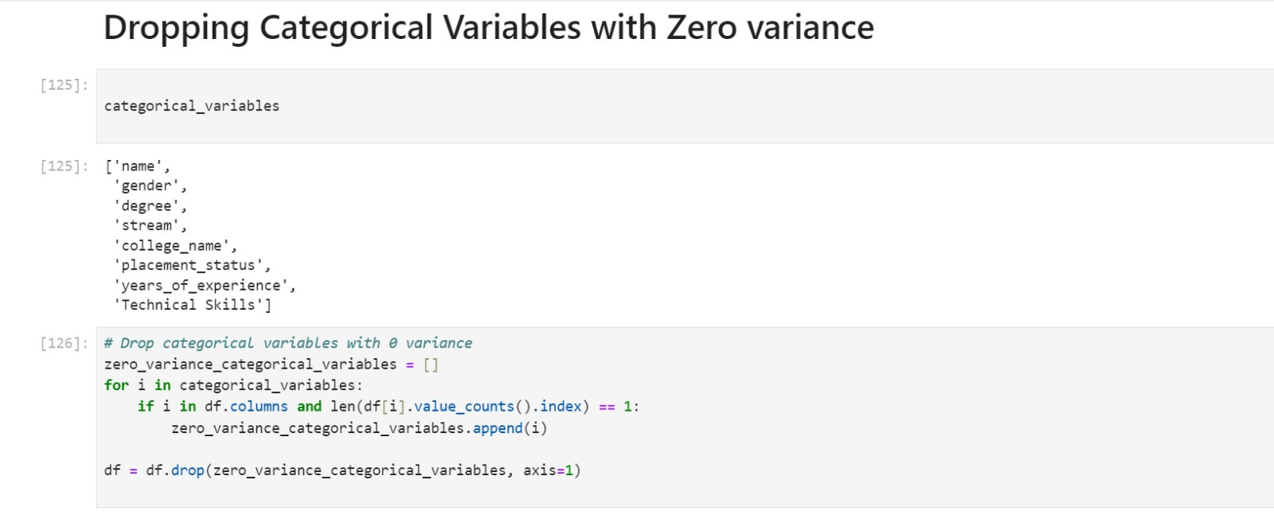
VARIABLE TREATMENT
The Python code provided is a data preprocessing step used in machine learning to remove features from a dataset that have no variance, meaning they have the same value for every observation. Such features do not contribute any meaningful information for modeling. The code iterates over a list of categorical variables, checks for zero variance, and drops those columns from the DataFrame. It ensures that the remaining features are potentially useful for predictive modeling by having variability in the data.

Slide 23
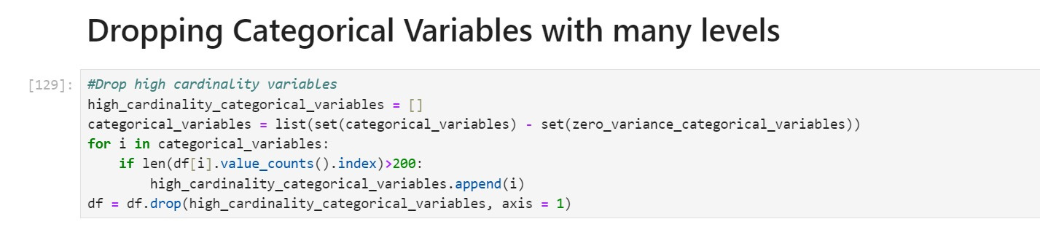
DROPPING CATEGORICAL VARIABLES
The code is designed to clean a pandas DataFrame by removing categorical variables that exhibit zero variance, meaning they have only one unique value across all observations. This is achieved by iterating over a list of categorical variables, identifying those with a single unique value, and then dropping these columns from the DataFrame. The process enhances the quality of the dataset by ensuring that only variables with meaningful information are retained for analysis.

Slide 24
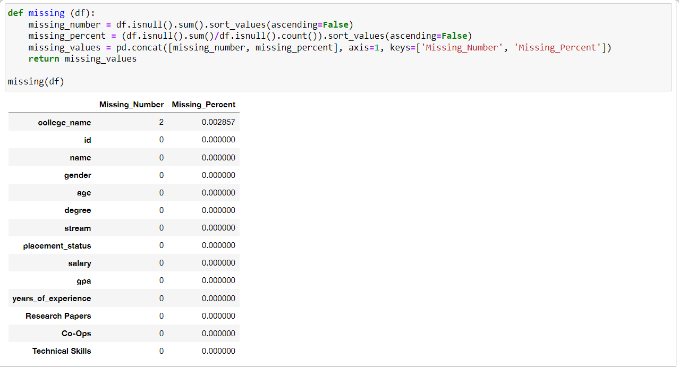
IMPUTING MISSING VALUES

Slide 25
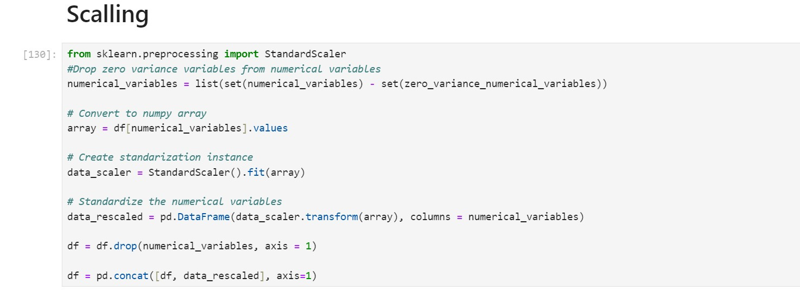
TRANSFORMING VARIABLES

Slide 26
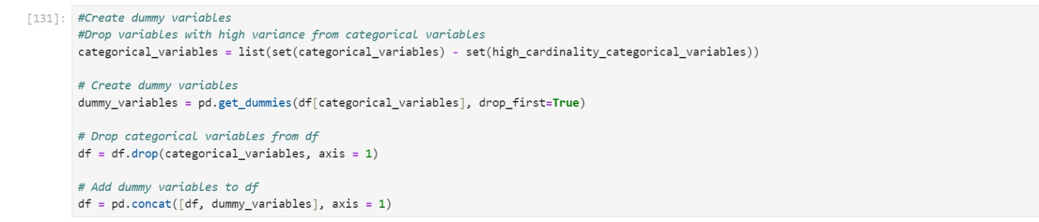
TRANSFORMING VARIABLES
The code performs data preprocessing for machine learning. It removes numerical variables with zero variance, standardizes remaining numerical variables using StandardScaler, and then reintegrates them into the DataFrame. It also handles categorical variables by removing those with high cardinality, creating dummy variables, and merging them back. Finally, it converts the ‘salary’ column to integer type, preparing the dataset for model training with standardized numerical inputs and encoded categorical features.

Slide 27
FITTING MODELS

Slide 28
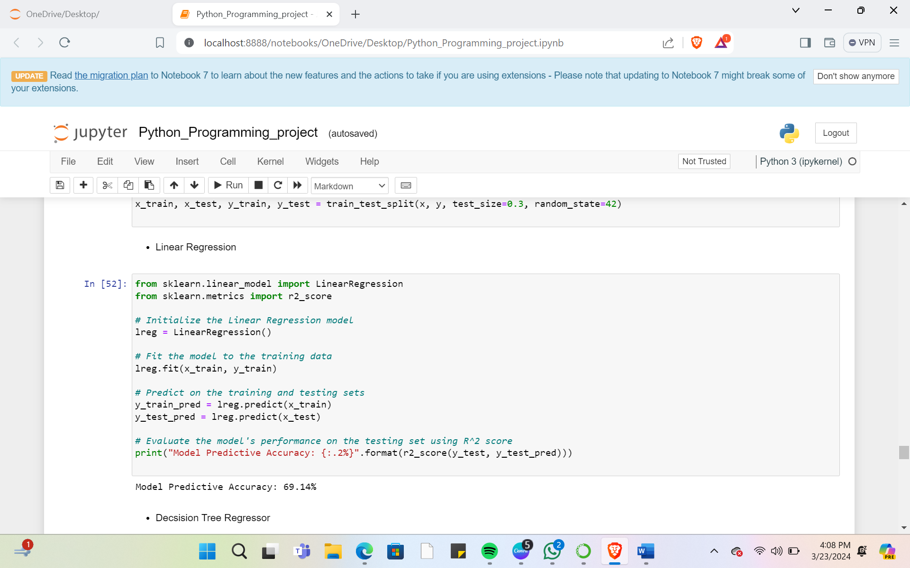
LINEAR REGRESSION

Slide 29
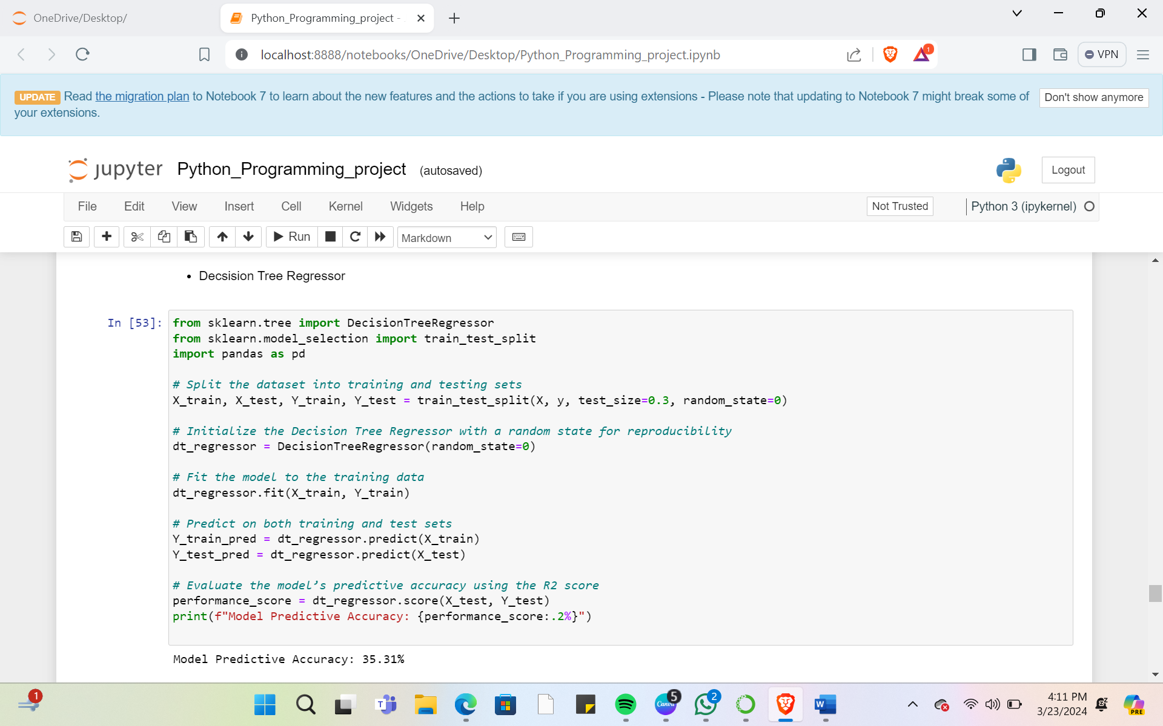
DECISION TREE REGRESSION

Slide 30
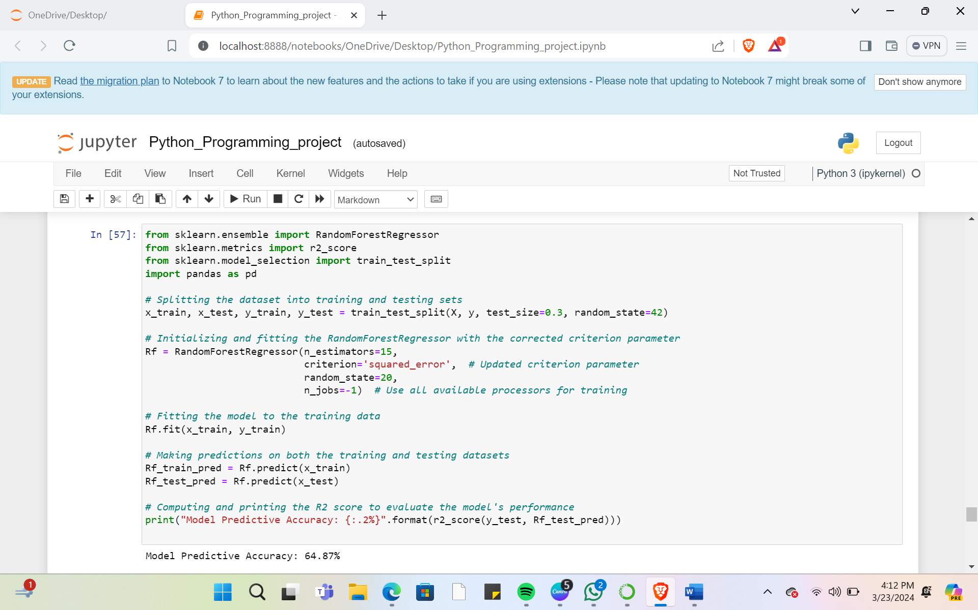
RANDOM FOREST REGRESSION

Slide 31
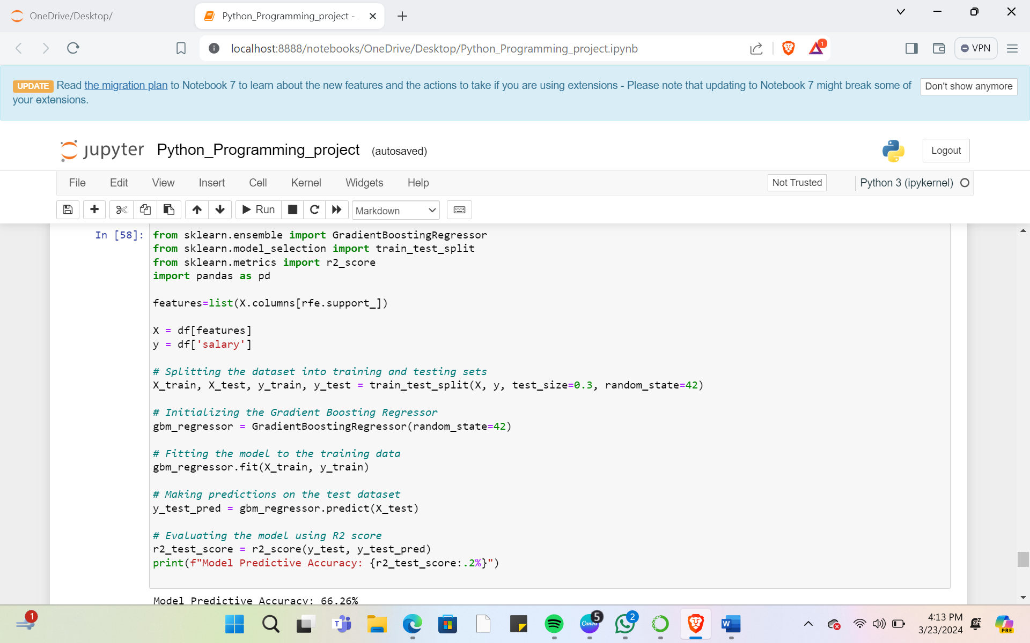
GRADIENT BOOSTING REGRESSION

Slide 32
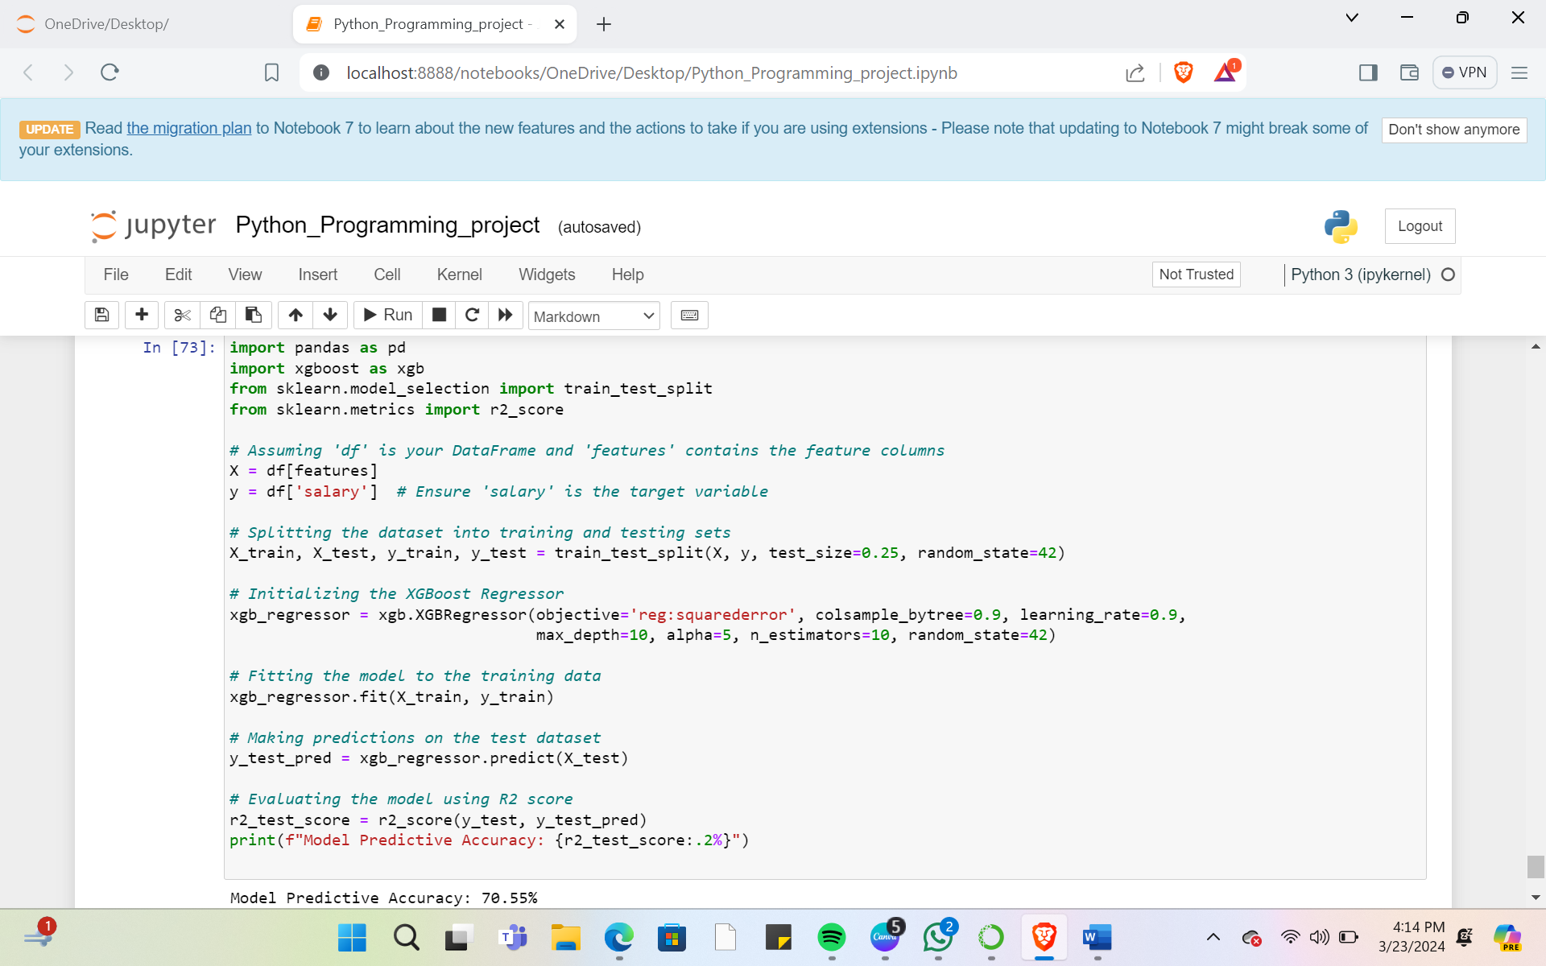
XG BOOST REGRESSION

Slide 33

Here we, applies various predictive models. The models are as follows:
Linear Regression
Random forest regression
Decision tree regression
Gradient Boosting Regression
XG Boost Regression
As we put these different models to testing we got the following predictive accuracies from each model:
Linear Regression 69.14%
Random forest regression 64.87%
Decision tree regression 35.31%
Gradient Boosting Regression 66.26%
XG Boost Regression 70.55%
And as we can see that XG Boost Regression model gives the highest accuracy. Therefore, we conclude that for this particular data set the Best Model is XG Boost Regression Model
BEST MODEL

Slide 34

THANK YOU
Arjun Malgwa
Anmol Fernandez
Hitankshi Jain
Ishita Poorey
Vaishali Patidar

